Slide 1
Notebooks, PowerShell and Excel Automation
Rob Sewell
He/Him,
Beard Twizzler,
Sewells Consulting Ltd

Slide 2
Explore PASS

Slide 4

Rob Sewell
Bearded Consultant, Automator, Trainer
He/Him
Beard Twizzler
Sewells Consulting Ltd
@SqlDbaWithBeard
blog.robsewell.com
beard.media/book dbachecks PowerShell & Data Community

Slide 5
Rob Sewell He/Him
@SqlDbaWithBeard
blog.robsewell.com

Slide 6

Content

Slide 7
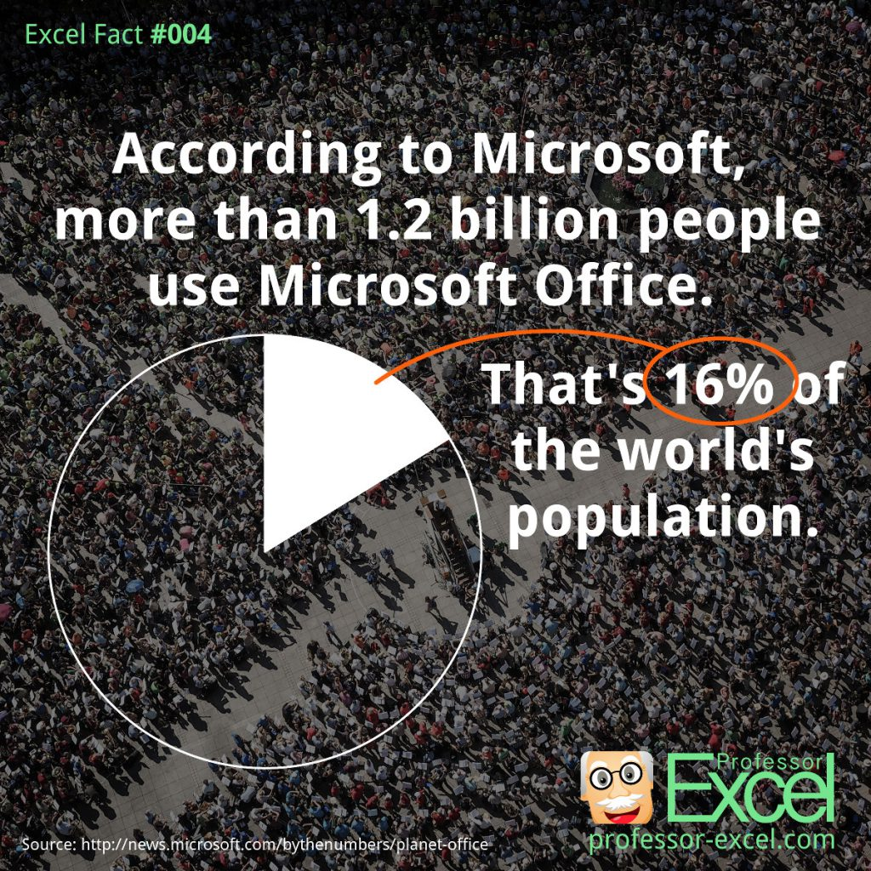
Content

Slide 8

Content

Slide 9
Content

Slide 10
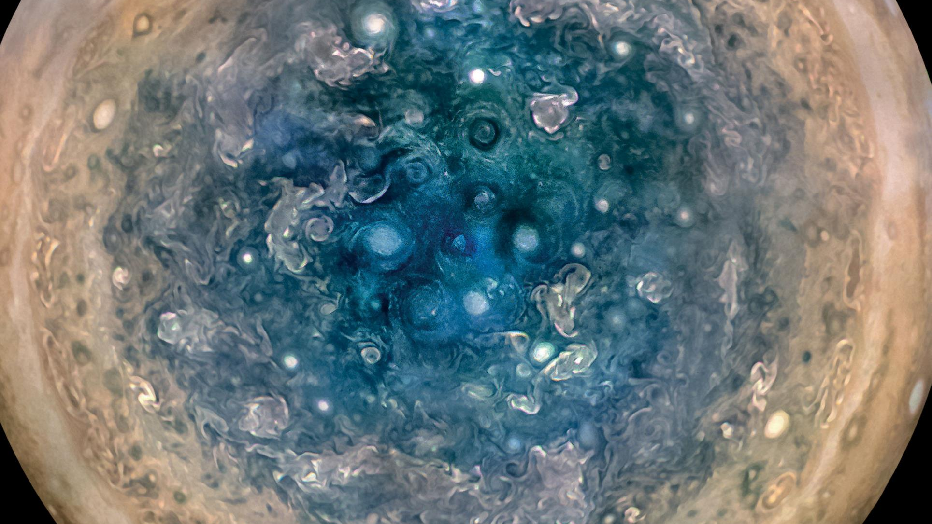

Slide 11

What is a Jupyter Notebook?
Originally for Data Scientists

Slide 12

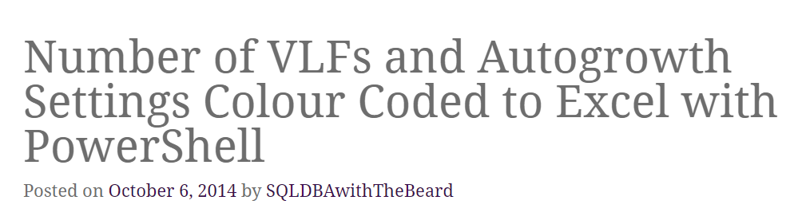

Slide 13
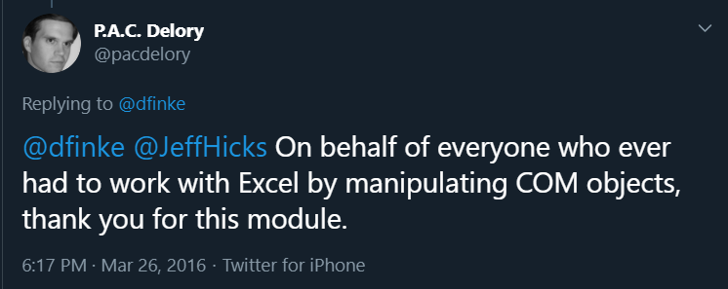

Slide 14

Time For A DEMO

Slide 15
Palette

Slide 16
Font Colors

Slide 17
Social Media Icons
Social Media Icons - Reference Slide
Copy and paste the appropriate icon next to your Social Media handle on both the Speaker Profile slide and the Thank You slide.

Slide 18
Agenda

Slide 19
Section Title 1

Slide 20
Section Title 2

Slide 21
Section Title 3

Slide 22
Section Slide One Point

Slide 23
Section Slide Two Points

Slide 24
Section Slide Three Points

Slide 25
Slide for Developer Software Code
Use this layout to show software code.
The font is Consolas, a monospace font.
The slide doesn’t use bullets but levels can be indented using the “Increase List Level” icon on the Home menu.

Slide 26

Table
Table Style
Heading | Heading | Heading
Table data here | Table data here | Table data here
Table data here | Table data here | Table data here
Table data here | Table data here | Table data here
Table data here | Table data here | Table data here
Table data here | Table data here | Table data here

